Slide 1
Education Inequality Results
This project addresses inequality of educational opportunity in U.S. high schools. Here we will focus on average student performance on the ACT or SAT exams that students take as part of the college application process.
We expect a range of school performance on these exams, but is school performance predicted by socioeconomic factors?

Slide 2
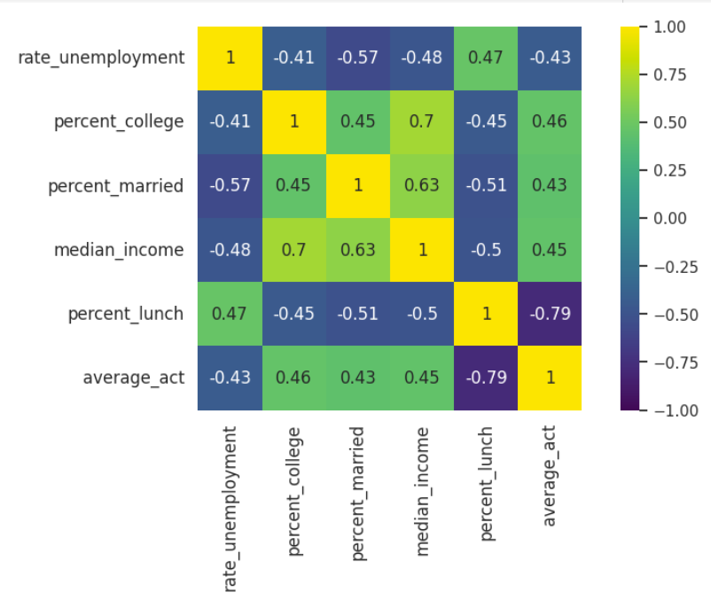
Heat map that represent the correlation between variables
Here we observe that ‘average_act’ and ‘percent_lunch’ have the strongest negative correlation.
From here, we can make a hypothesis that ‘percent_lunchh’ is the most significant variable on predicting the ACT score.

Slide 3
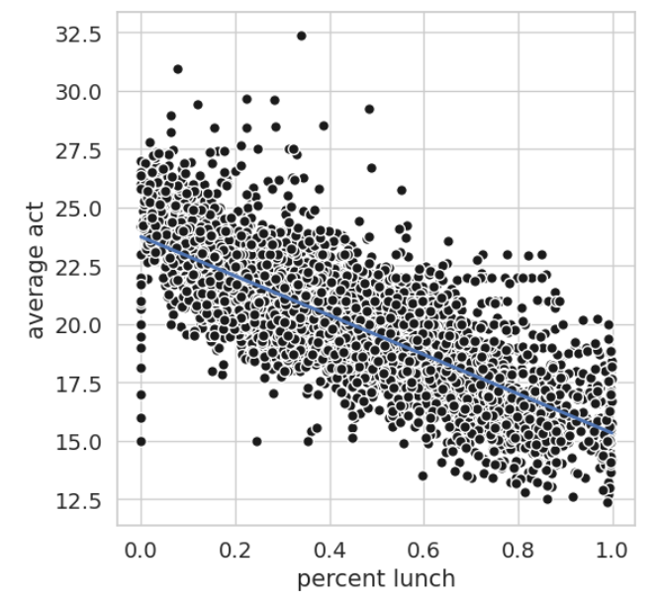
Visualising of the negative correlation between ‘percent_lunch’ versus “average_act’. We can see here that the regression line show a strong downward slope represent the relationship between the predictor and the target variable.

Slide 4
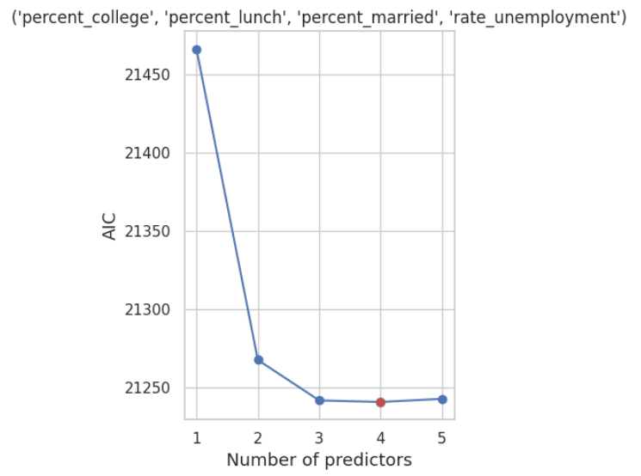
AIC is determined by fitting a broad class of maximum likelihood models. So the lowest AIC is the best model
After implementing the best subset selection algorithm on all combinations of variables, this plot visualizes the best subsets to predict the average ACT scores based on AIC values. This plots suggests that the subset of 4 variables has the best performance.

Slide 5
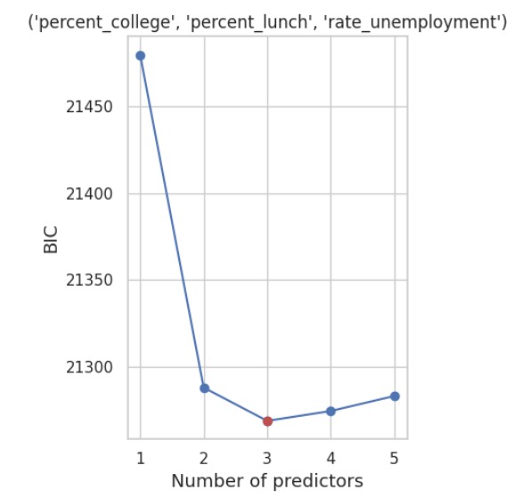
The ideal model is the one with the lowest BIC value. Low test error is indicated by a low BIC score.
Based on BIC values, this plot suggests that the three-variable subset does the best at predicting our target variable.

Slide 6
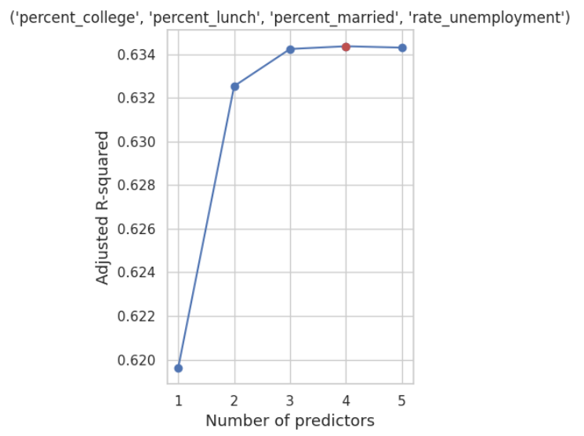
The concept of adjusted R^2 states that all appropriate variables should be included in the model; if additional variables are added, the model will become noisier. This indicates that increasing the noise lowers adjusted R^2. Therefore, in theory, the biggest corrected R^2 would contain only right variables and no noise variables.
With that, the subset that performs the best is the 4 variables subset on the adjusted R squared standard.

Slide 7
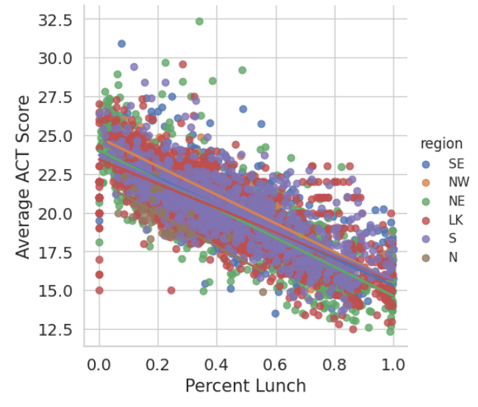
To better predict the the ACT score and enhance the performances of the predicting model, I added a new variable ‘region’ to answer the question that is the ACT scores affected by geographic factor. This plot shows the regression lines between ‘percent_lunch’ and ‘average_act’ in different region.
We can see that they are all relatively have the same relationship. With further examination, I learned that ‘region’ does not strengthen the performance of the model as ‘region’ is not a significant variables in predicting the ACT scores.

Slide 8
Conclusion
To answer my big question:
Percent Lunch and other variables are more significant at predicting the average ACT score.
The added attribute 'region' is not a strong deciding factor to determine ACT scores.
This results is not optimal because there are a few missing factors that hinder the performance of the models. The dataset is missing a few important predictors. For example, there are limited data from some states as well as missing the information that some states might or might not require SAT/ACT scores.

